Slide 1
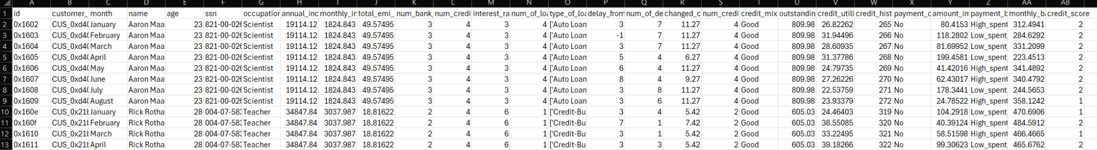
Introduction
Found our dataset from kaggle
Factors include outstanding debt, income, and number of delayed payments
In total, 27 columns worth of features, 1 column for ternary classification

Slide 2
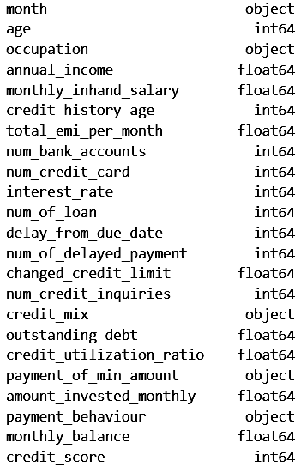
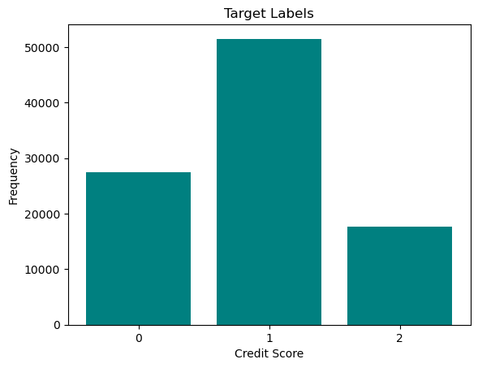
Dataset
N = 96,696 with 20% test split
28.4% with “0” class
53.3% with “1” class
18.3% with “2” class
17 numerical features
6 non-numerical

Slide 3
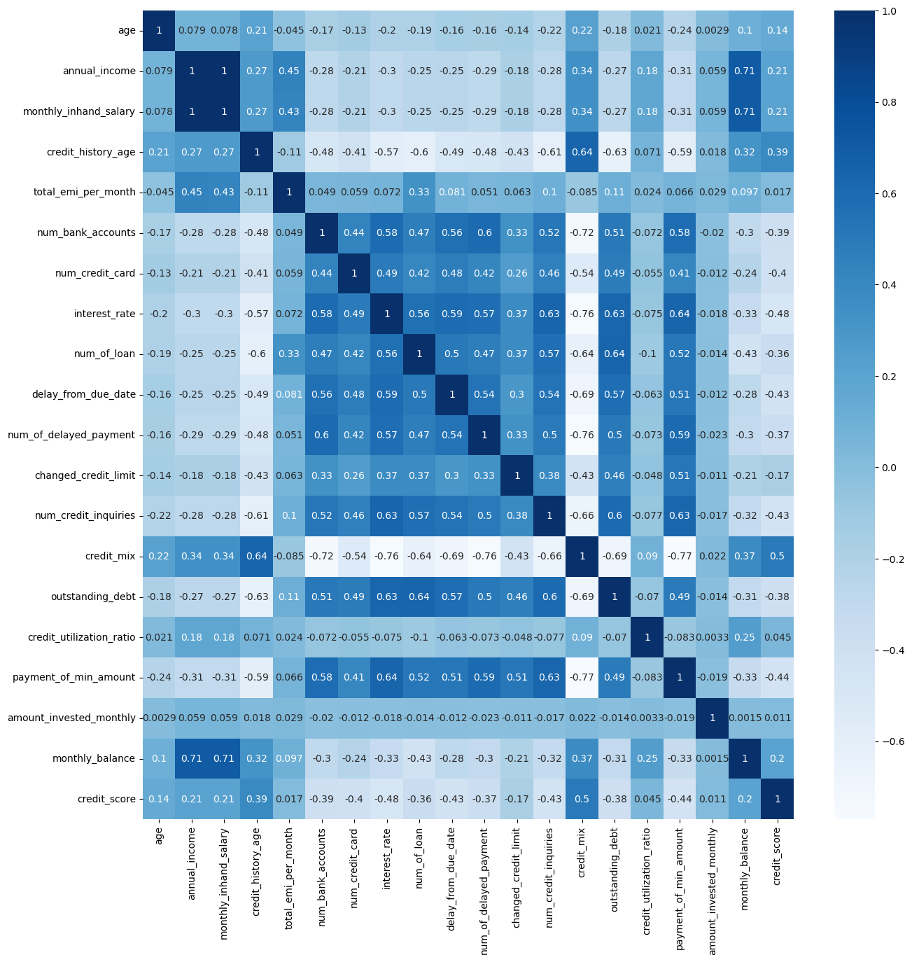
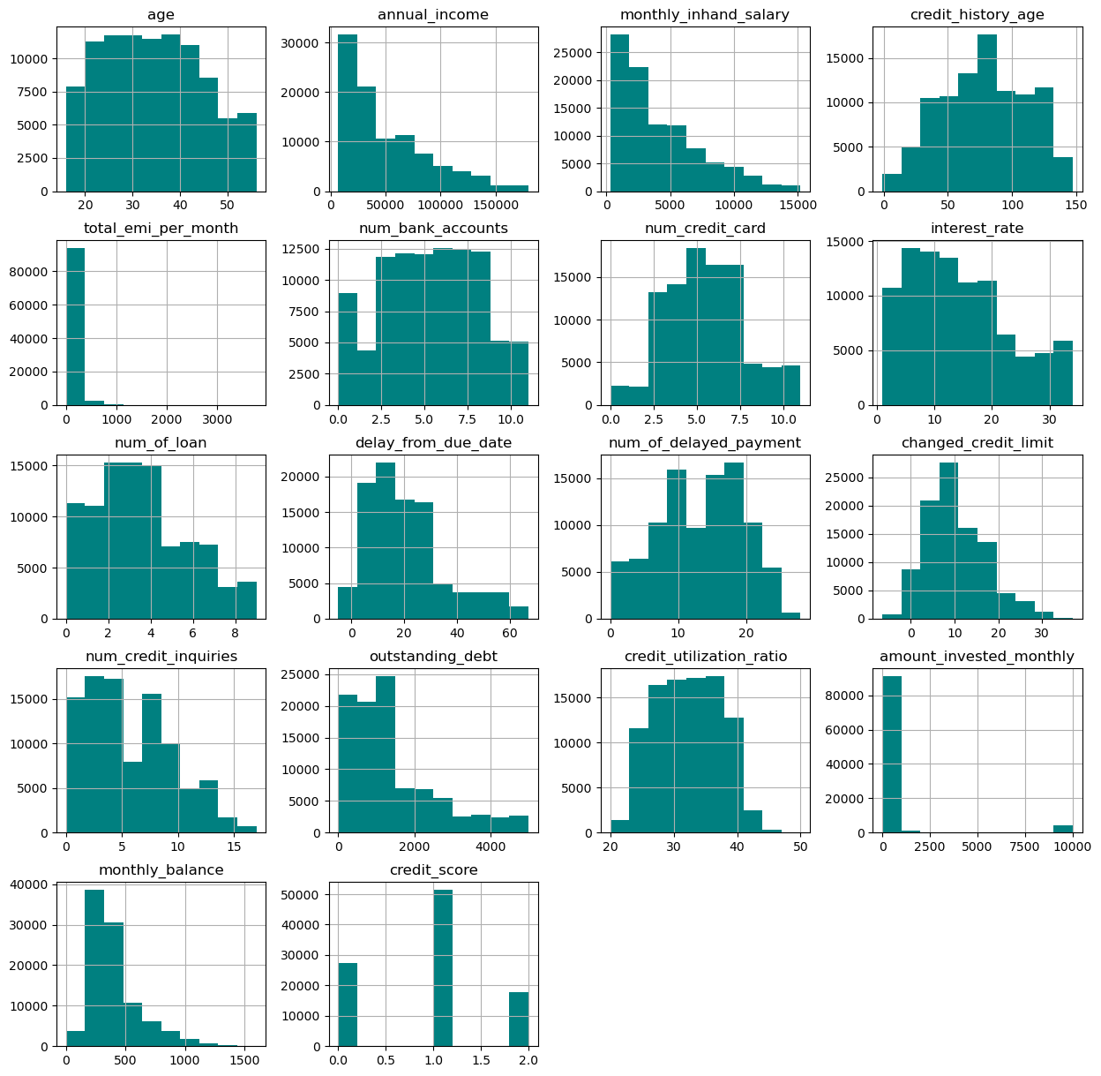
Exploratory Data Analysis

Slide 4
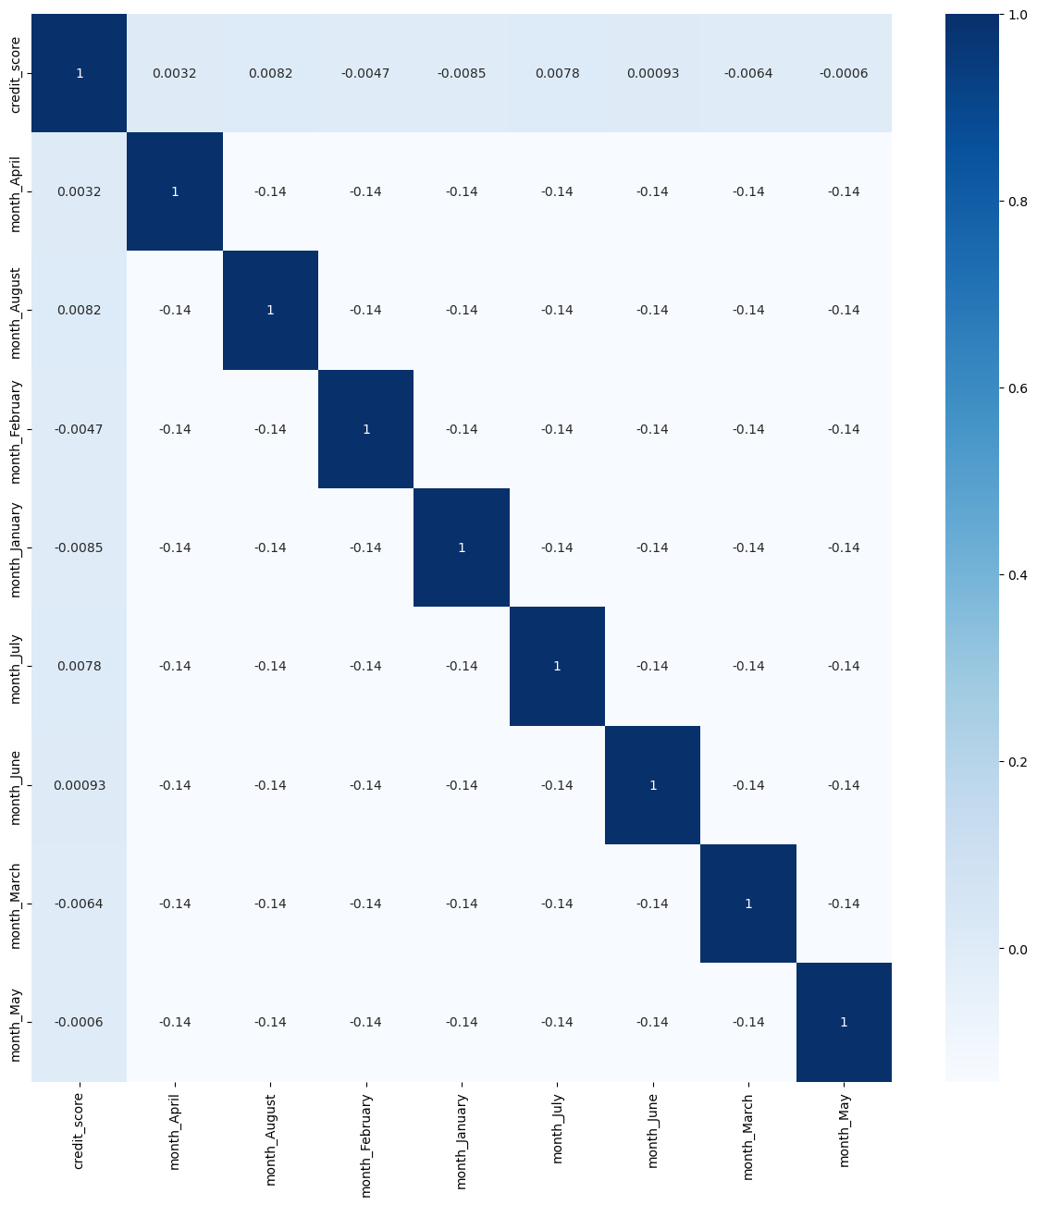
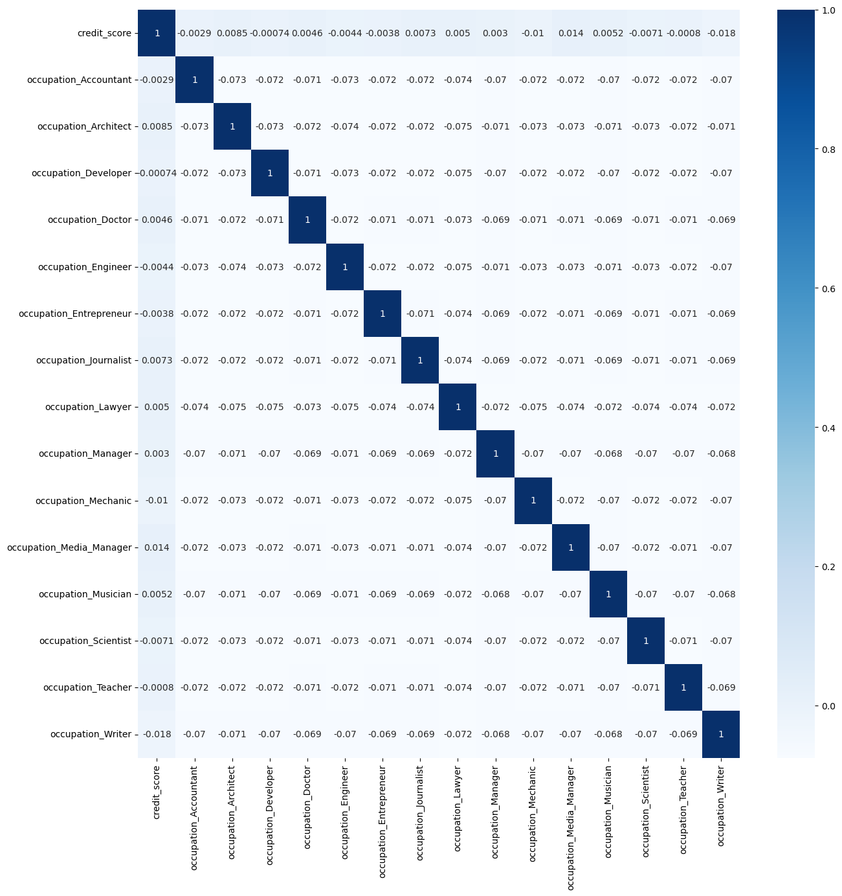

Slide 5
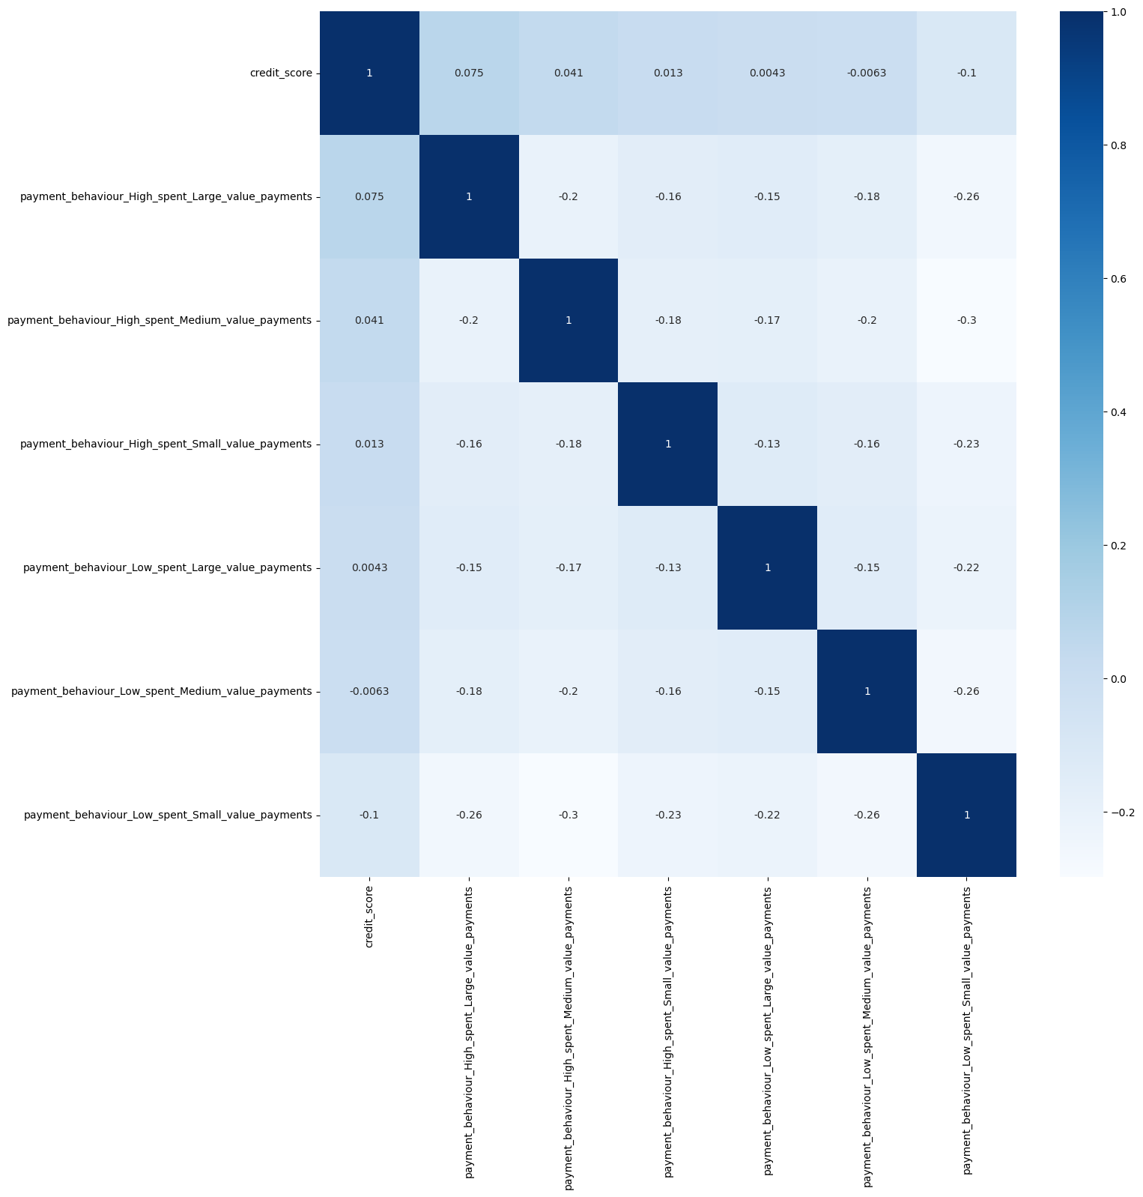

Slide 6
Preprocessing
Removed irrelevant columns (name, ID, SSN)
Removed array data types
Removed categorical features
Ordinal features encoded as integers (credit mix, payment of minimum amount)
Categorical features tested with one-hot encoding
Min-max scaling as normalization
80-20% train test split

Slide 7
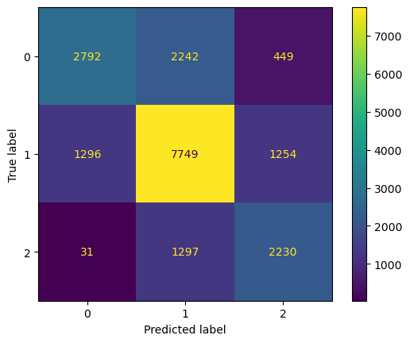
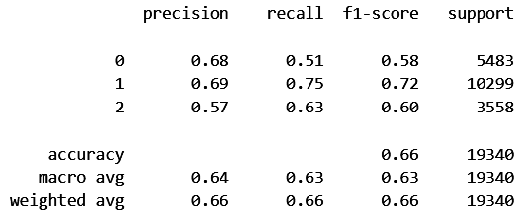
Logistic Regression
Multinomial logistic regression
66% accuracy

Slide 8
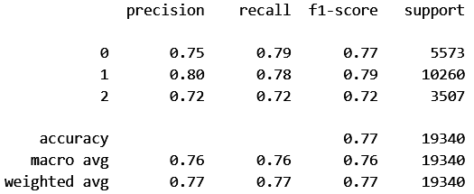
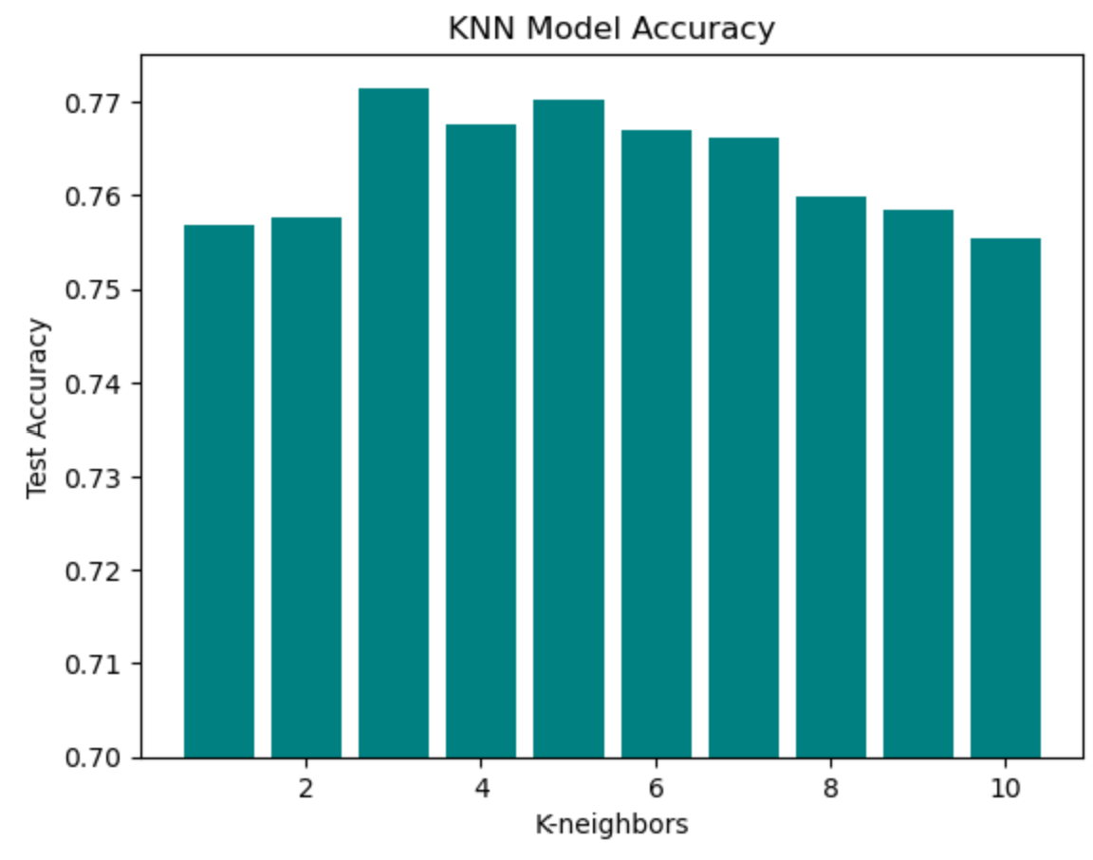
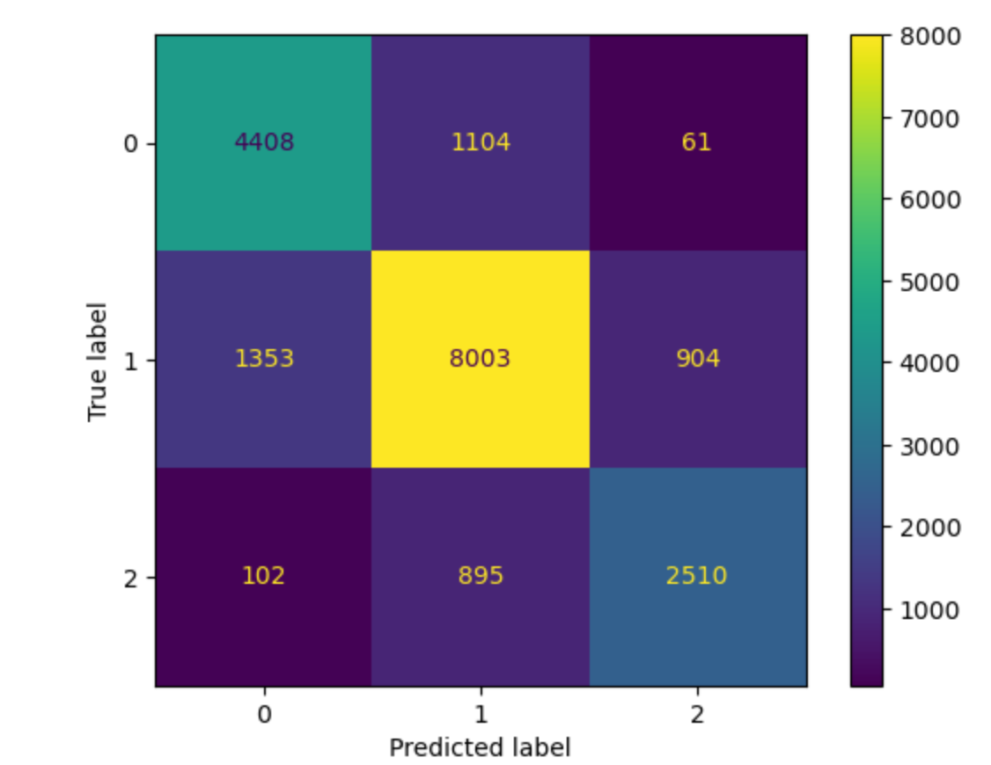
K-Nearest Neighbor
77.1% accuracy with k = 3
Overlapping data
24% increase in accuracy from random (53%)

Slide 9
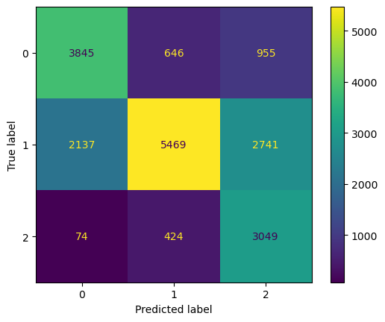
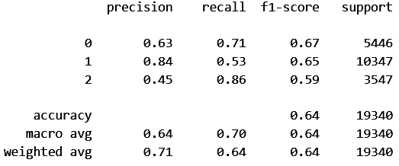
Naive Bayes
Gaussian Naive Bayes
63.92% accuracy

Slide 10
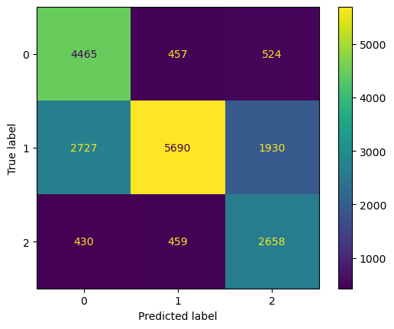
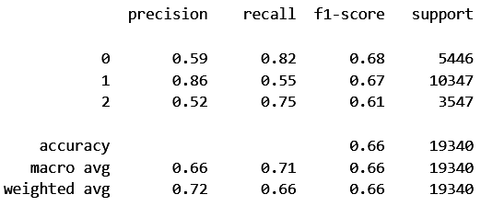
C5.0 Decision Tree
65.1% accuracy
Max depth = 3, max leaf nodes = 5
0.59 and 0.52 precision for class 0, 2

Slide 11
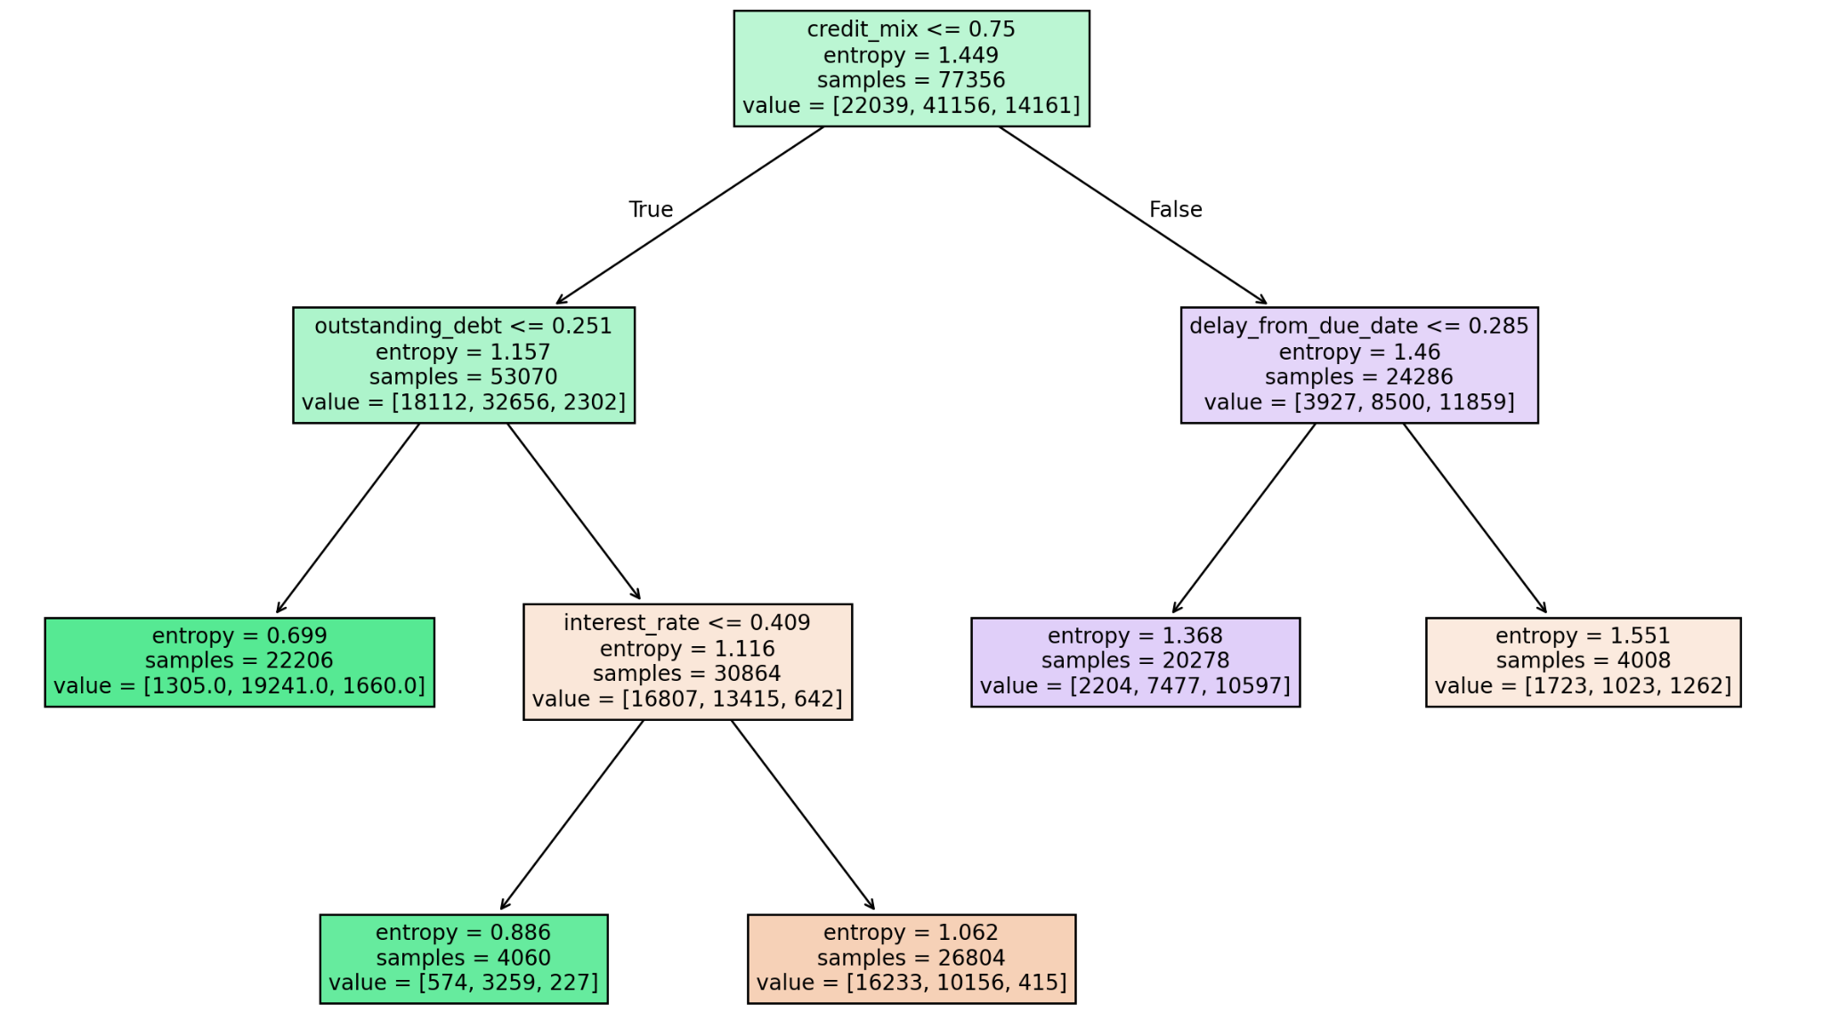

Slide 12
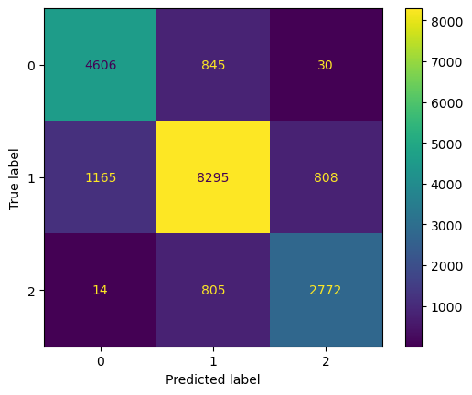
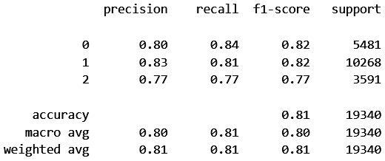
Random Forest
Gini criterion
81% accuracy

Slide 13
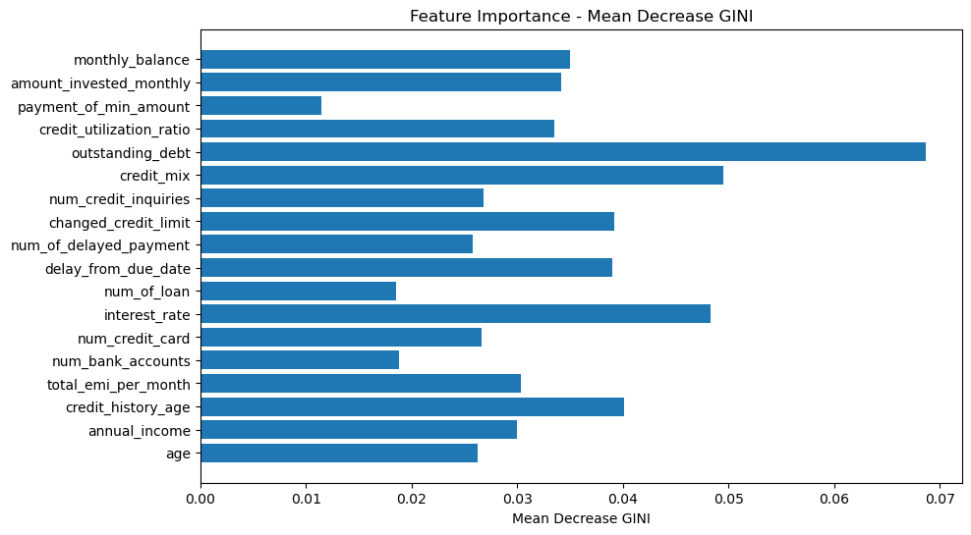

Slide 14
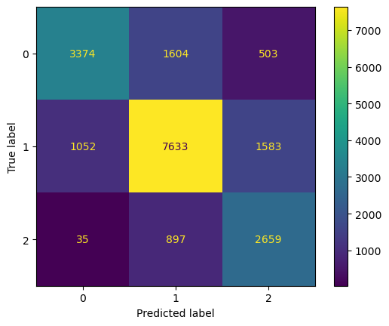
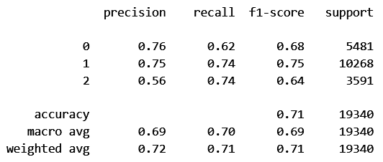
Support Vector Machine
RBF Kernel
71% accuracy
0.56 precision for class 2

Slide 15
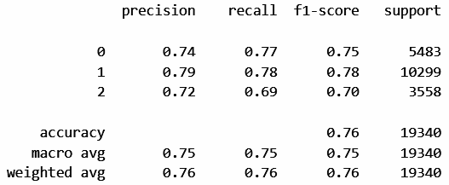
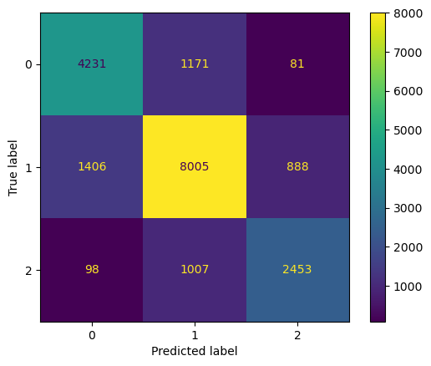
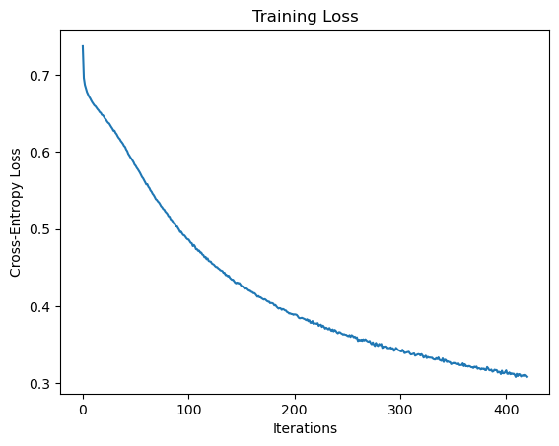
Artificial Neural Network
76% accuracy
18, 128, 256, 3 neuron layers

Slide 16
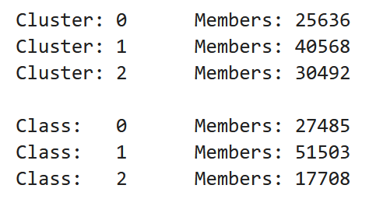
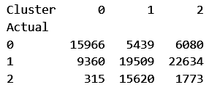
K-means Clustering
Unable to accurately learn clusters that correspond to classifications
Learned clusters marginally follow the true classes

Slide 17
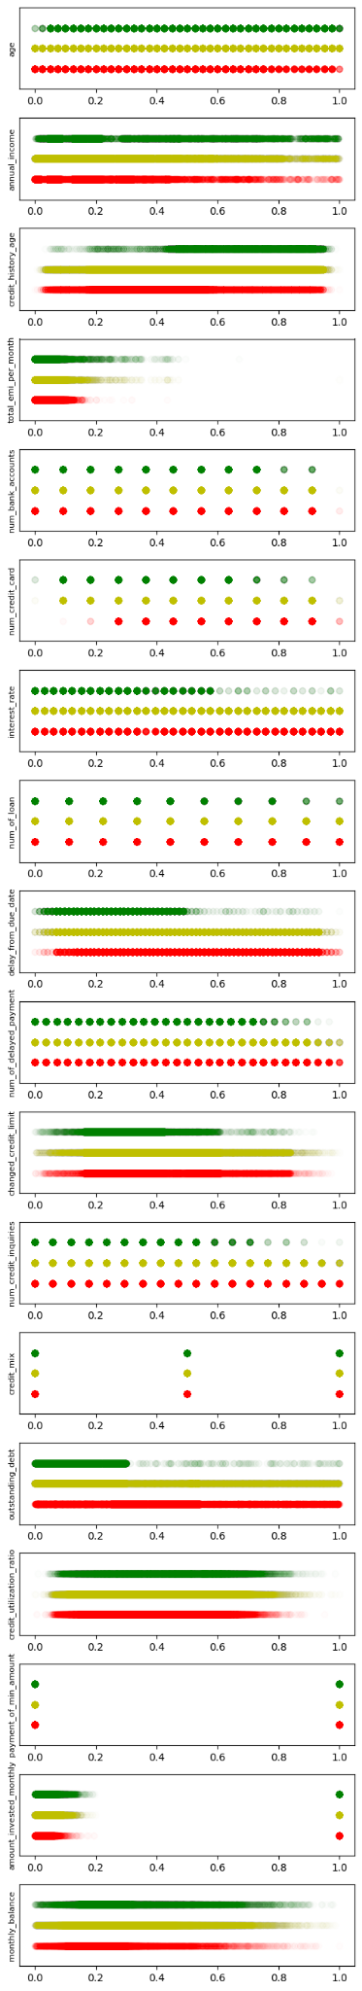

Slide 18
Conclusion
 | Log Reg | KNN | NB | C5.0 | RF | SVM | ANN | k-means
Accuracy | 66% | 77% | 64% | 66% | 81% | 71% | 76% | —
Random Forest and KNN performed the best
Logistic Regression, Gaussian NB, and C5.0 performed the worst
SVM and ANN were the slowest
K-means failed to identify clusters

